Slide 1
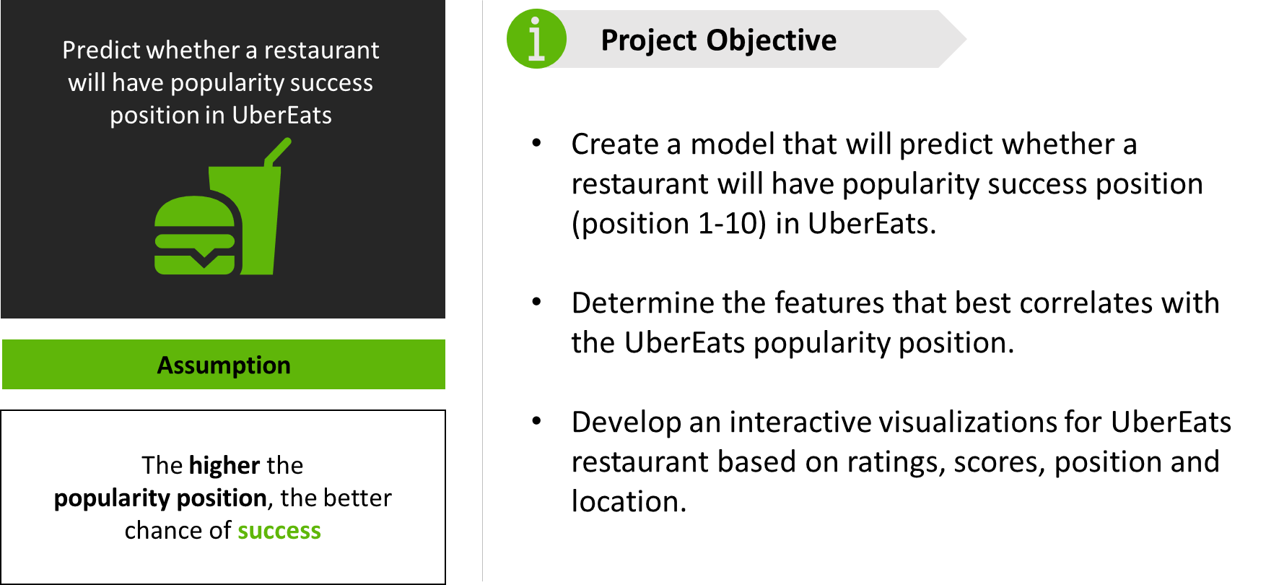
Project 4 Foodies

Slide 2
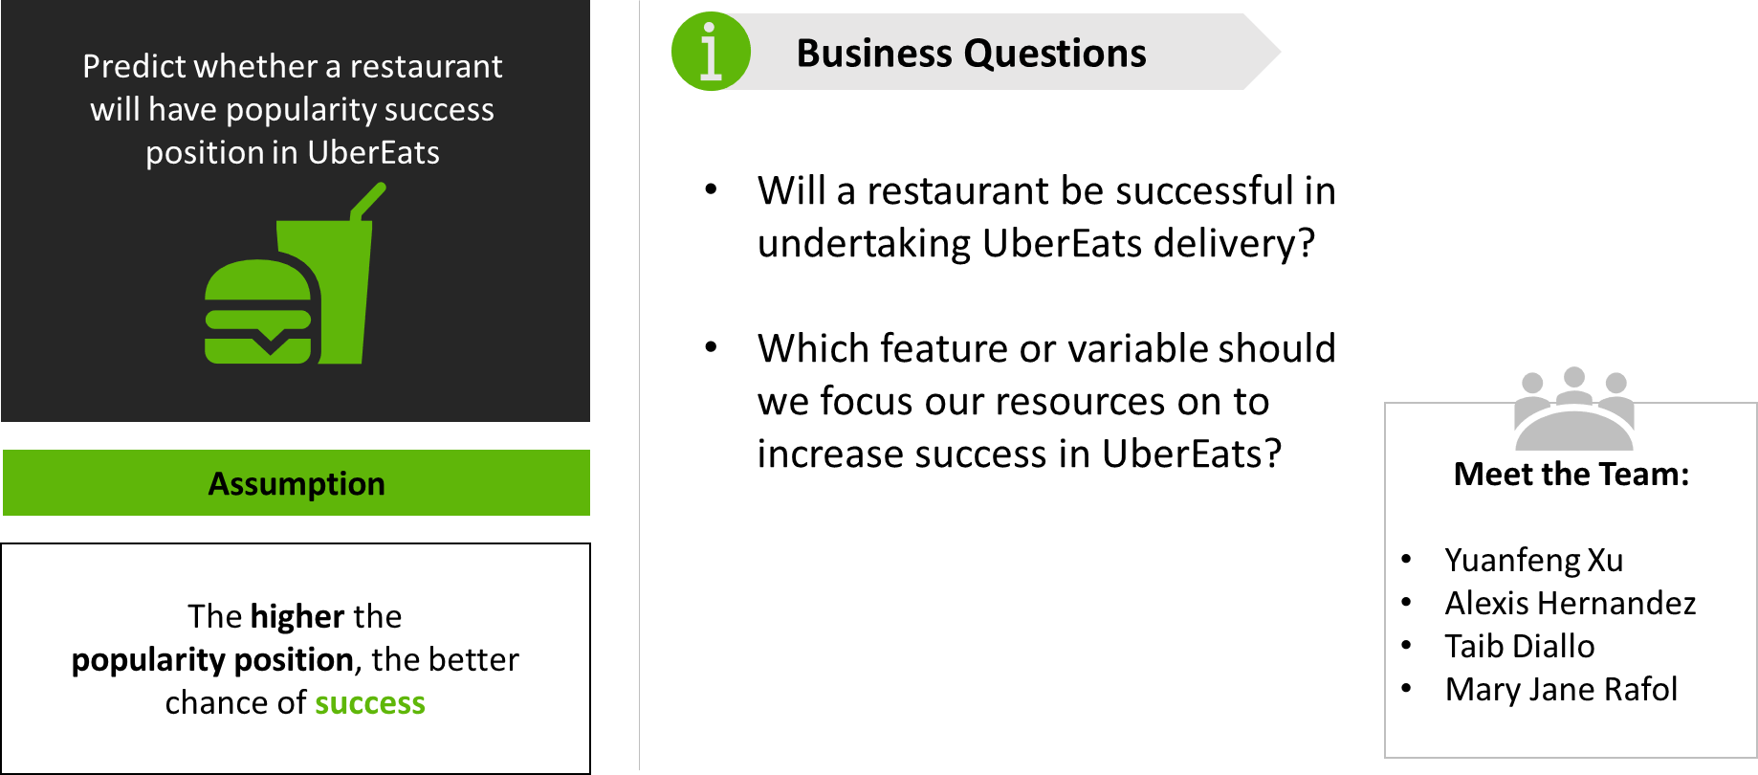
Project 4 Foodies

Slide 3

Project 4 Foodies
Methodology
1
2
3
4
Identify Data Sources
Prepare
Data
Identify Feature Correlation
Perform Data Clustering
UberEats USA restaurant and menu data
ETL,
Feature Engineering
Linear Regression
K-means, Hierarchical Clustering, DBScan
5
5
Develop a Machine Learning Model
Create Interactive Visualization
Random Forest Classifier, Logistic Regression, Hypertuning
Tableau

Slide 4

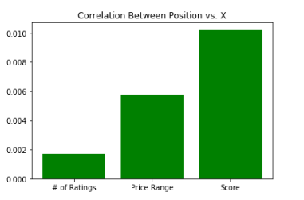
Project 4 Foodies
Linear Regression
Performed linear regression on 3 different features
# of Ratings
Price Range
Score
Method
Score
Conclusion
No strong correlation

Slide 5
Project 4 Foodies
Clustering
Our original dataset does not have any target variable to predict
Unsupervised Learning to explore or identify grouping patterns in data sets
Clustering Methods Used:
K-means
Hierarchical Clustering Linkage Methods
Density-Based Spatial Clustering of Application with Noise

Slide 6
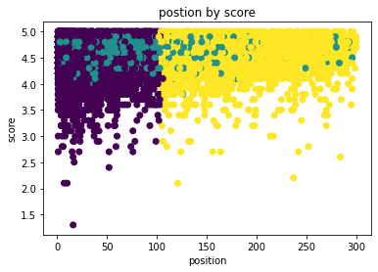
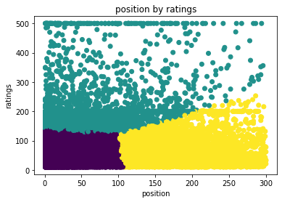
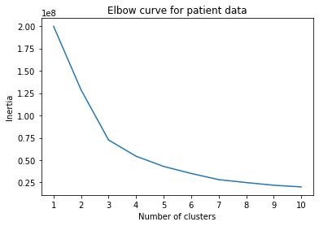
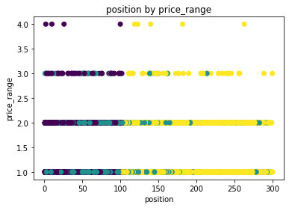
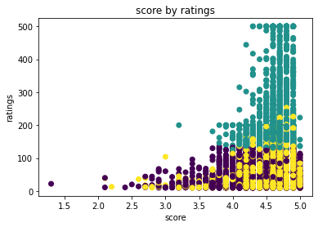
Project 4 Foodies
Clustering
K-Means without Scaled Data

Slide 7
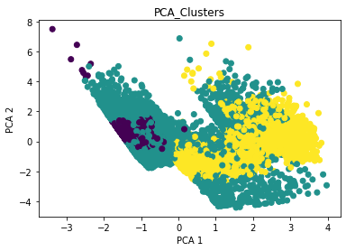
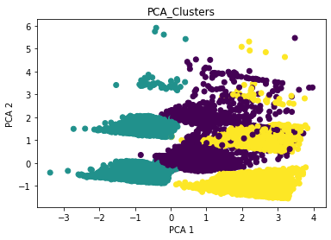
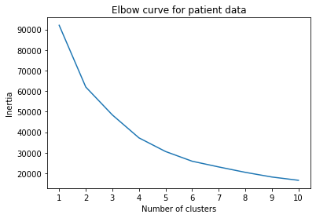
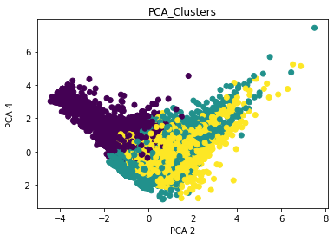
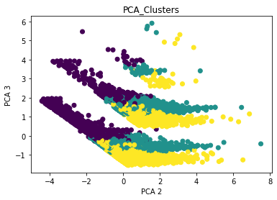
Project 4 Foodies
Clustering
K-Means with PCA and Scaled Data

Slide 8
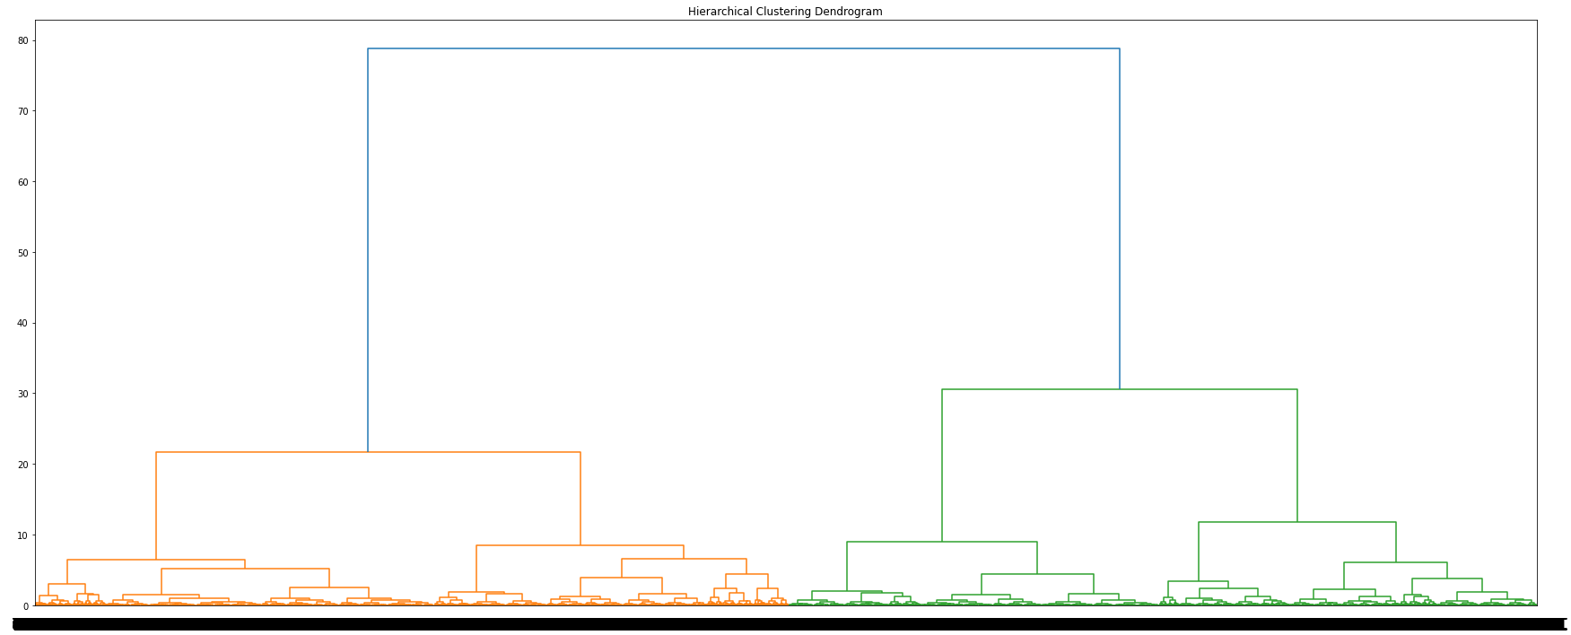
Project 4 Foodies
Clustering
Hierarchical Clustering Linkage Methods

Slide 9
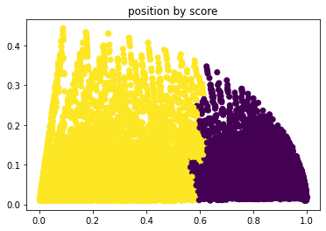
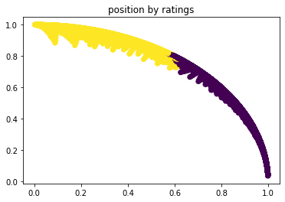
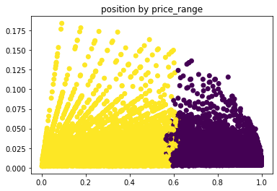
Project 4 Foodies
Clustering
Hierarchical Clustering Linkage Methods
Create scatter plots with two of the features, based on Agglomerative Clustering

Slide 10
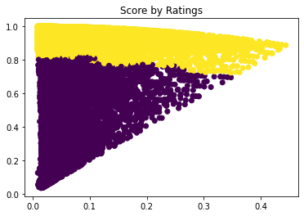
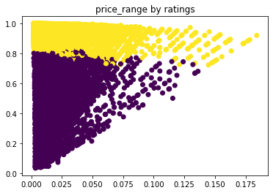
Project 4 Foodies
Clustering
Hierarchical Clustering Linkage Methods
Create a scatter plot with two of the features, based on Agglomerative Clustering

Slide 11
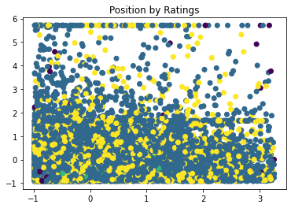
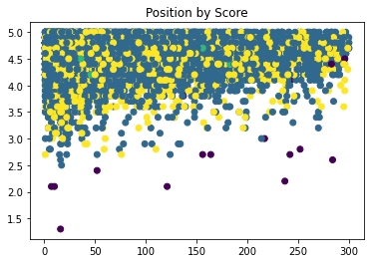
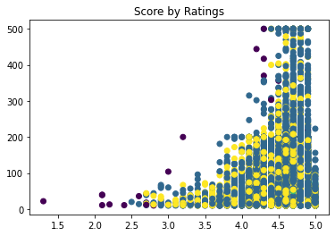
Project 4 Foodies
Clustering
Density-Based Spatial Clustering of Application with Noise
Initial the DBSCAN model: eps=1, min_samples=10
The model returns 4 clusters, as well as outliers (noise)

Slide 12
Project 4 Foodies
Clustering
Disadvantages with Unsupervised Learning
Uncertainty about the accuracy of the unsupervised learning outputs, as there are no labeled data sets to verify the results;
Difficulty interpreting and labeling results with unsupervised learning than they would with supervised learning; and the lack of full insight into how or why an unsupervised system reaches its results.
Overestimate the similarities in the input objects.

Slide 13
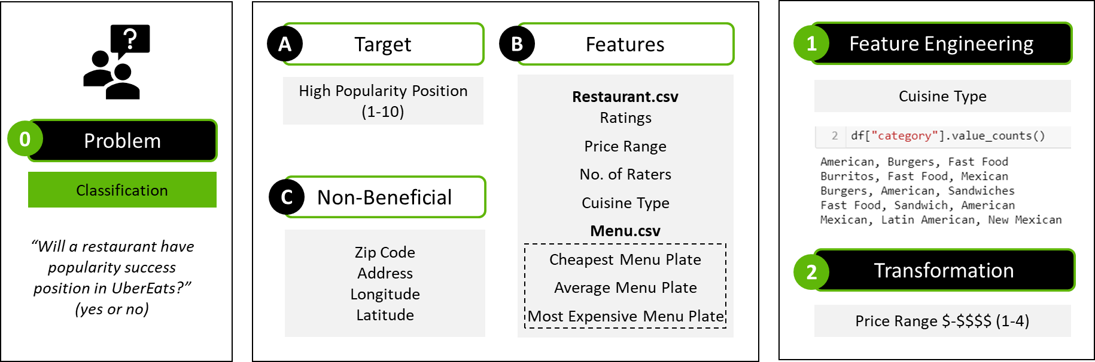
Project 4 Foodies
Machine Learning Model

Slide 14
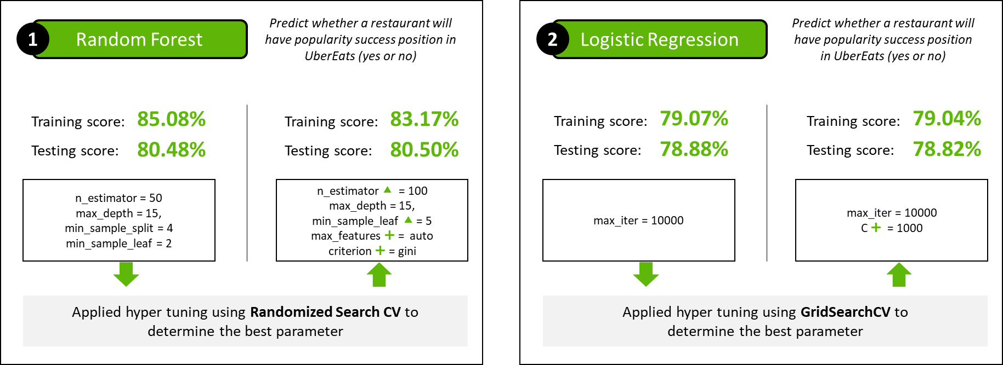
Project 4 Foodies
Machine Learning Model

Slide 15
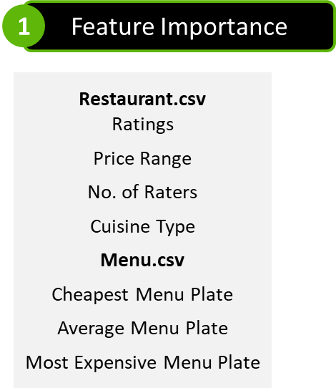
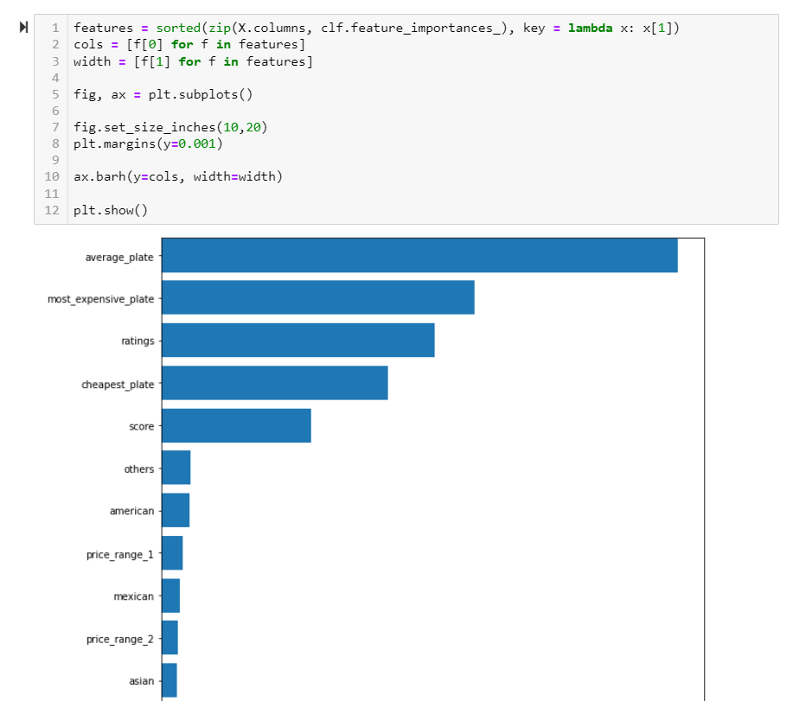
Project 4 Foodies
Machine Learning Model

Slide 16
Project 4 Foodies
Interactive Visualizations
Data preparation included joins, bins, split, create sets and groups in Tableau.
Mapping all the IDs (restaurants), across a virtual map.
Explorer TabPy, which is a Tableau Analytical Extension that expands software capabilities by allowing users to execute Python scripts and saved functions.
Performed a Linear Regression between Rating and Score in Tableau.
Go to Tableau

Slide 17
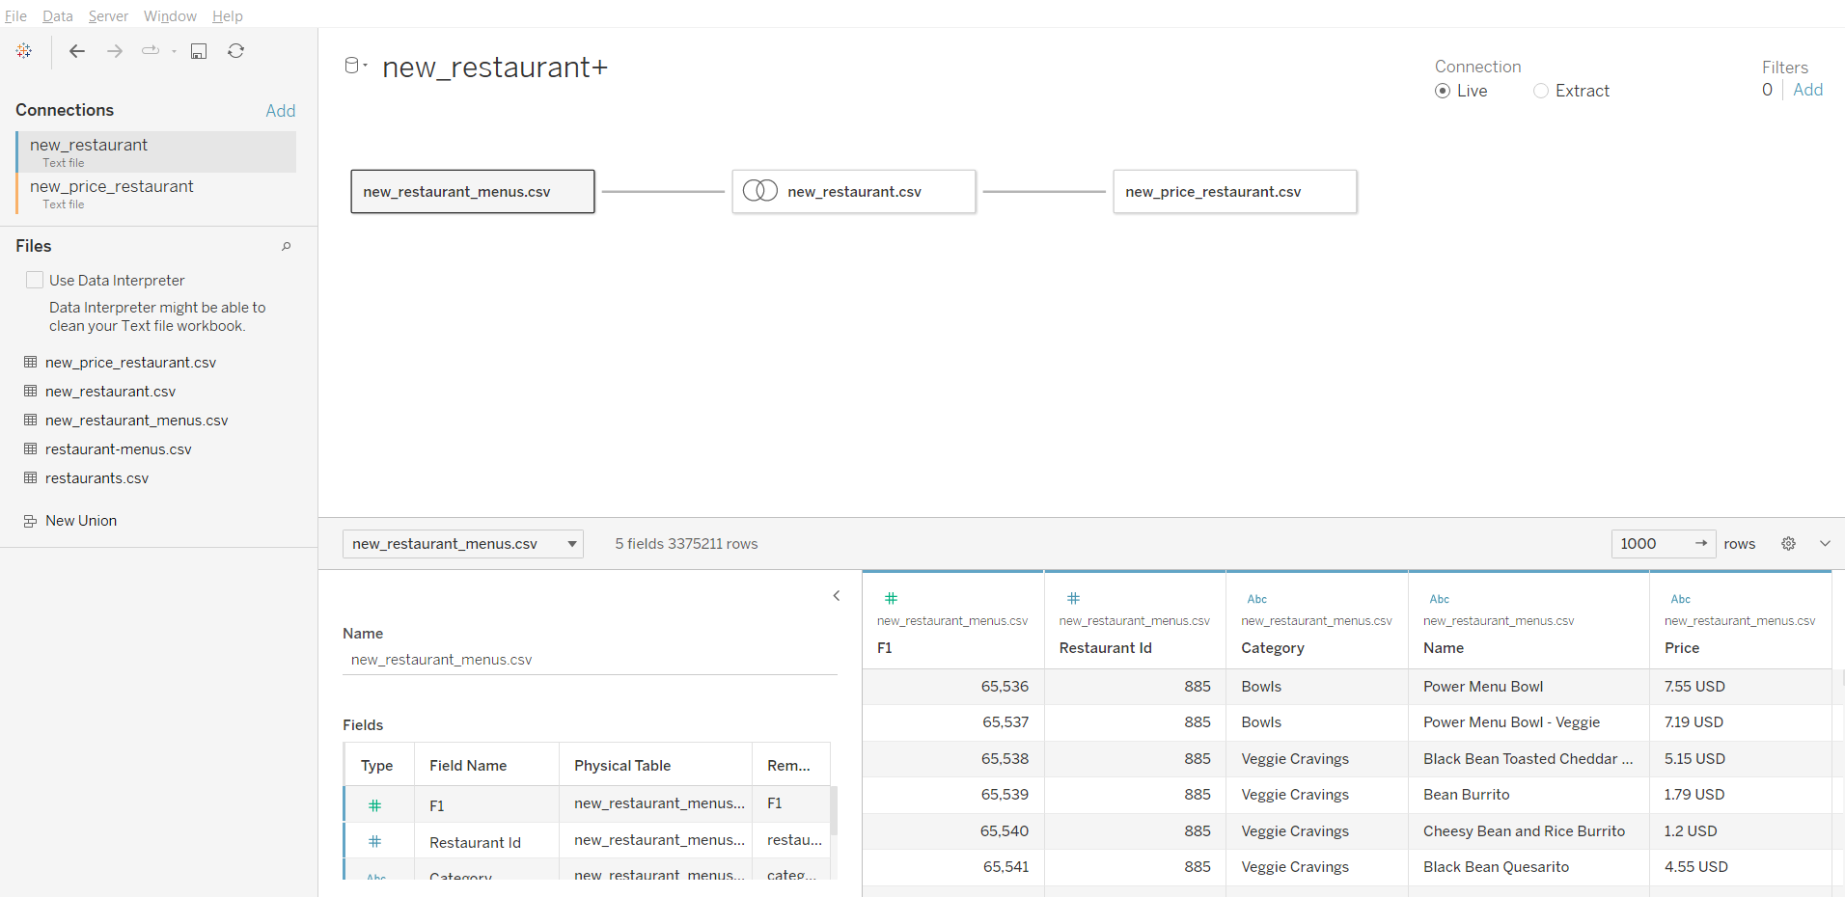
Project 4 Foodies
Interactive Visualizations

Slide 18
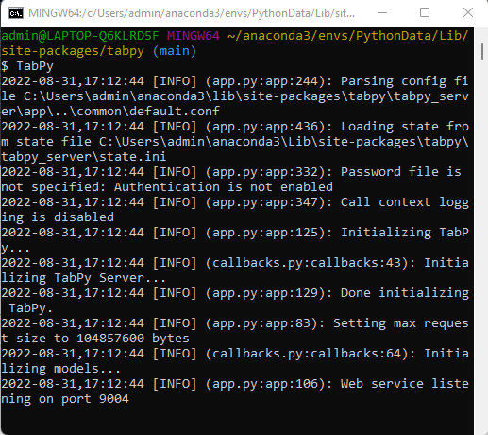
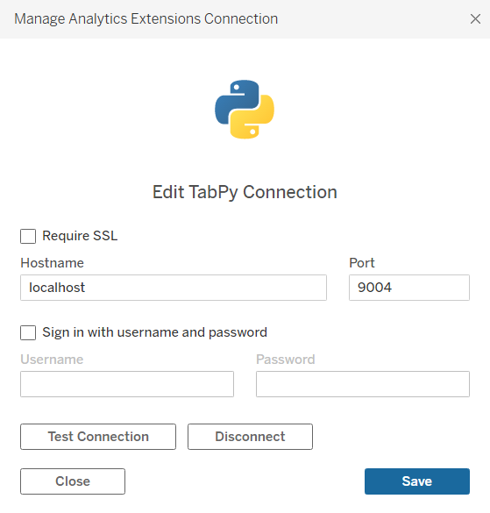
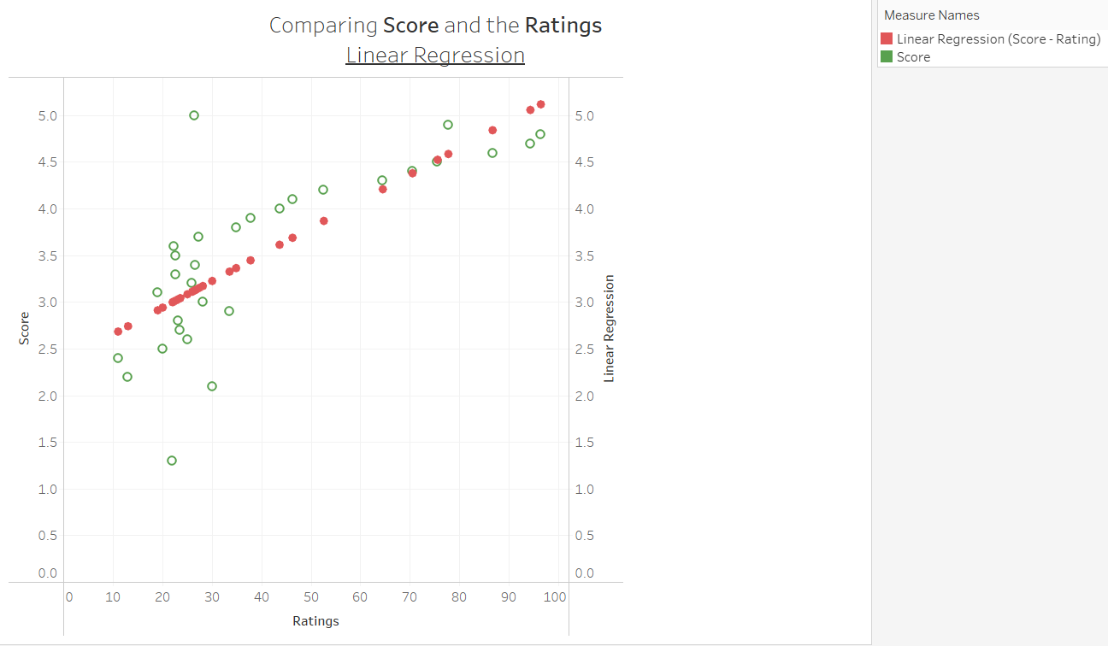
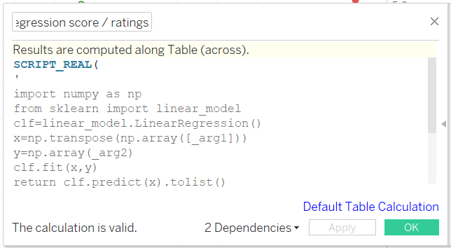
Project 4 Foodies
Interactive Visualizations

Slide 19

Project 4 Foodies
Limitations
Predicting the restaurant’s popularity position of in UberEats
Unbalanced Data.
Most Categorical Data than Binary.
No restaurants financial data to predict success.
More than 50% of data has null values.
Not nationwide data.
UberEats developer web page require payment to scrape.
Assumption
The higher the
popularity position, the better
chance of success

